Slide 1




TeraScan Curriculum Development and Integration of SeaSpace Technology into the Classroom

Slide 2


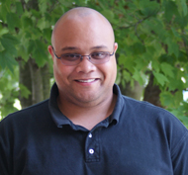
Remote Sensing Team
Kalyx McDonald
Mississippi Valley State University
Courtney Farmer
Elizabeth City State University
Mentor: Mr. Je'aime Powell

Slide 3

Overview
Abstract
Purpose
Introduction
Methodology
Conclusion
Future Research
Acknowledgements
Questions

Slide 4
Abstract
SeaSpace and Elizabeth City State University (ECSU) signed a Memorandum of Understanding (MOU) in February of 2012. SeaSpace is the world's leading provider of satellite ground stations and processing software for remote sensing applications. The MOU stated that ECSU would provide a training site for SeaSpace's technology and data products along with integration of the products into classroom curriculum. In return, SeaSpace would provide ground stations for receiving direct broadcast data from various telemetries. The ground stations include a 3.7m X/L band, a 3.6m C band, and a 5.0m L band dishes, along with accompanying computing hardware. The purpose of this project was to generate a training curriculum focused on the K-12 classroom, along with college courses, and outside governmental agencies. The curriculum contains one hour modules which as a whole could be presented as a 10 hour course that qualifies as one continuing education unit (CEU) for K-12 teachers and administrators. Example modules for “Introduction to Remote Sensing” and “Introduction to TeraScan” were also created.

Slide 5
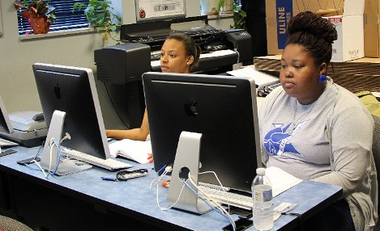
Purpose
Generate a curriculum focused on K-12 classes, college courses, & governmental agencies
Make the curriculum meet qualifications of one CEU
Notes:
The purpose of this project was to generate a training curriculum focused on the K-12 classroom,
along with college courses, and outside governmental agencies. The curriculum contains one hour
modules which as a whole could be presented as a 10 hour course that qualifies as one continuing
education unit (CEU) for K-12 teachers and administrators.

Slide 6
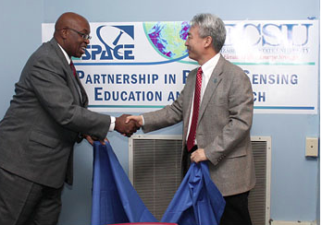
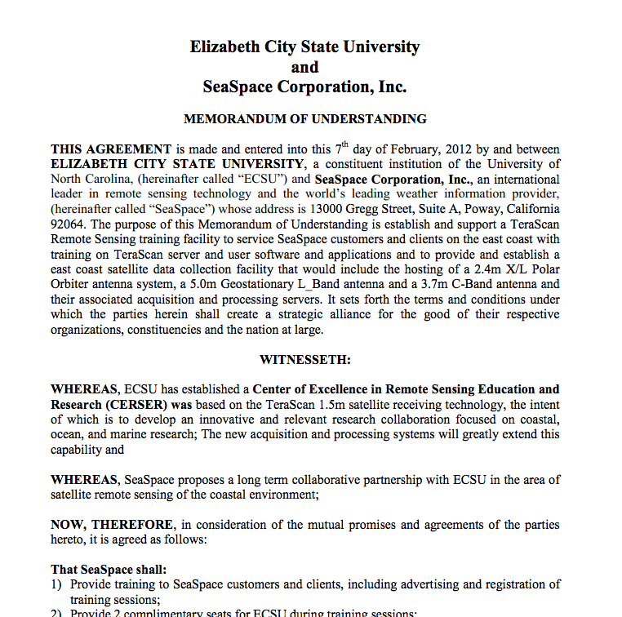
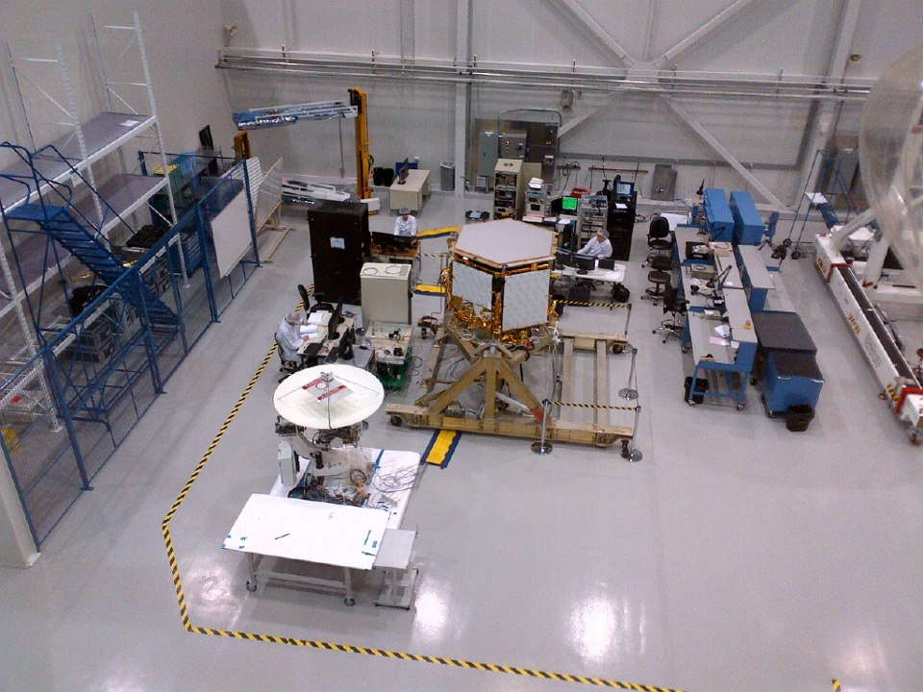
Introduction - MOU
On February 7, 2012 SeaSpace and Elizabeth City State University (ECSU) signed a Memorandum of Understanding.
Notes:
On February 7, 2012 SeaSpace and Elizabeth City State University (ECSU) signed a Memorandum of Understanding.
It says that ecsu must provide a training site, have a ground station running for 7 days with little to no human contact
and integrate SeaSpace technology into the classroom and research projects. In return SeaSpace will provide the ground stations
That we use to obtain raw data

Slide 7

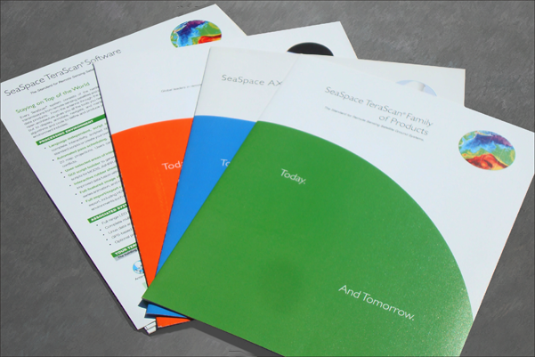
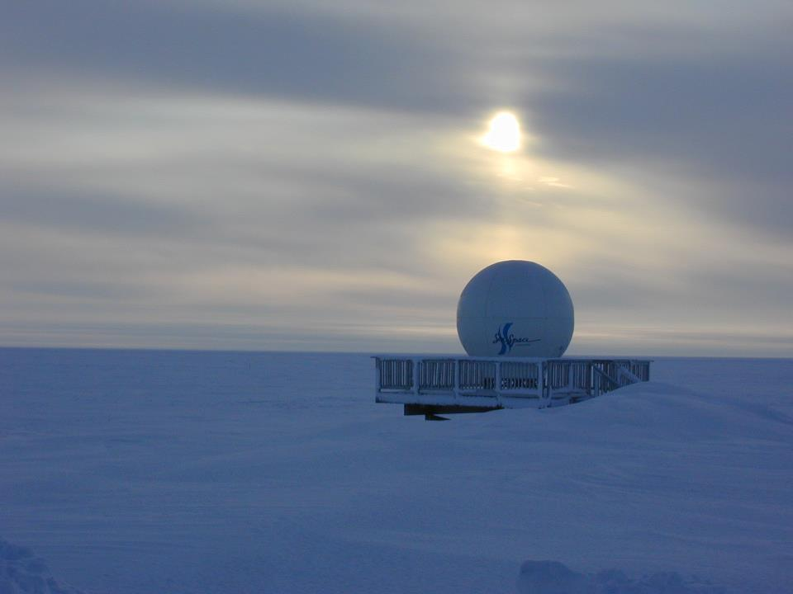
Introduction - SeaSpace
Founded in 1982
Notes:
It is one of the worlds largest Remote sensing companies. Their work allows ground station images to be captured for further research. One of the SeaSpace technology we focused on was TeraScan. TeraScan is an integrated system software designed for reception of data from environmental satellites for processing data into images.

Slide 8
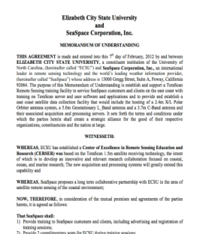
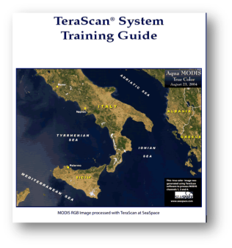

Methodology
MOU
SeaSpace training guide
Curriculum
ECSU Course catalog
Modules
Notes:
The group began their research by first dissecting the MOU signed by both ECSU and Seaspace. The required ground station systems, available data products, and target audience were expanded to meet the needs of the ECSU training site. The target audience included K-12 teachers and administrators with the goal of creating a curriculum that would allow student learners to attain a CEU. At this point the development of the course curriculum began. With the use of the Seaspace Terascan Training Guide and coursework from the Introduction to Remote Sensing , two introductory modules were created. In order to integrate the curriculum modules into the undergraduate/graduate courses at ECSU, course descriptions were analyzed individually using ECSU course catalog. The modules selected for development were “Introduction to Remote Sensing” and “Introduction to TeraScan”. Deliverables for each module included a self-running PowerPoint with voiceovers, an assessment, and a basic study guide for student learners.

Slide 9
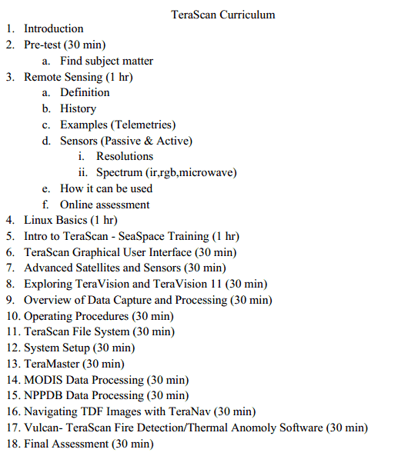
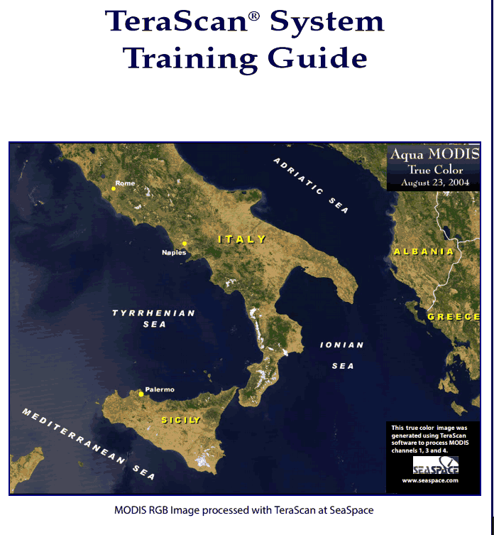

Curriculum
Target Audience: K-12 Teachers, Governmental Agencies & Higher Ed faculty & students
Standard: SeaSpace Training Guide
Notes:
Our curriculum was based on the American school counselor association which mandates that faculty must obtain
10 hours which is 1 ceu credit. We also used the TeraScan system training which allows us to stick to our mou while using the given seaspace technology to provide a ceu credit here at the uviversity
Common core:
earth/environmental science- understanding energy and conservation

Slide 10

Classes for Integration
Introduction to TeraScan
RS 503: Digital Image Processing and Analysis
CSC 160: Computer Science Majors Orientation Software
CSC 460: Senior Seminar in Computer Science
Introduction to Remote Sensing
RS 501: Geophysical Remote Sensing
RS 504: General Analytic Methods of Remote Sensing
RS 506: The principles of Microwave Remote Sensing
Notes:
These are a few of our classes picked out for integration. We chose these because our introductory modules will be able to give
A better understanding of the classes and expectations. You cannot take a remote sensing class without knowing the purpose of being there. With our introductory module you can prepare for that geophysical remote sensing class and even integrate SeaSpace technology.

Slide 11
5E Methodology
Engage
Explore
Explain
Elaborate
Evaluate
Notes:
Introduction to the 5E
The 5E consist of five point which are Engage, explore, explain, elaborate and evaluate.
Engage is when the learner has a need to know and addresses their issues of what they don’t understand
Explore is when the learner gathers ad evaluates the topic and knowledge given to them
Explain & Elaborate is when the learner tells what they have learned after finding examples needed for better understanding and begins making conclusions
Evaluate Takes what they have learned for further use elsewhere
The purpose of the 5E is an easier way to work with students and their learning process. We used the 5E during the Introduction modules to provide a basic understanding without overwhelming new learners and provide a sense of knowledge.

Slide 12
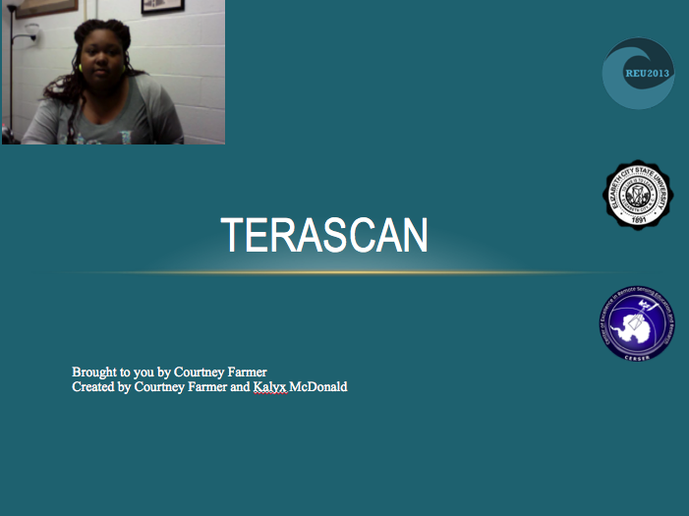
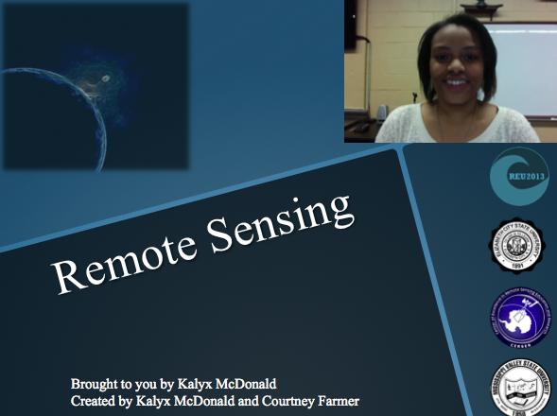
Example Modules
Self running PowerPoint with voice overlay
Study guide
Assessment
Notes:
To make it easy for the viewer our modules are all self suffienct. Meaning it runs by itself with voice overs. A study guide to follow along at your own pace and an assessment for teachers and viewers to test their new knowledge

Slide 13
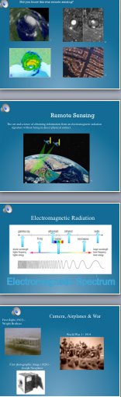
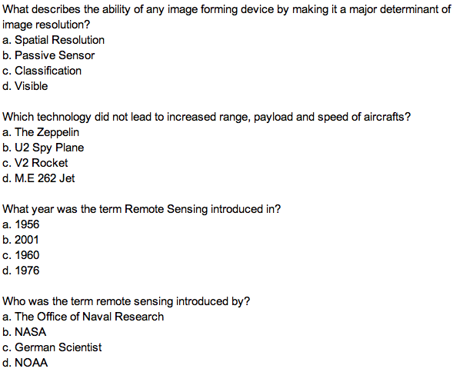
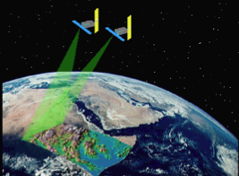
Introduction to Remote Sensing
Assessment Questions
Notes:
In the introduction to remote sensing module the viewer is intended to understand basic concepts about remote sensing. They will be able to learn the definition, how we obtain satellite imagery, the technology that started remote sensing along with take an assessment. As you can see we have some of the questions.

Slide 14
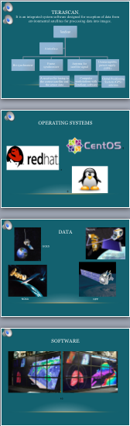
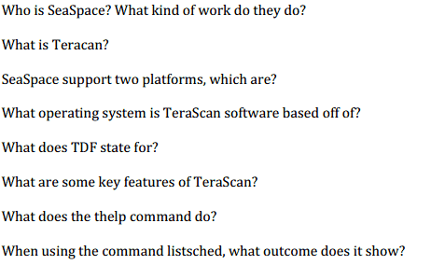
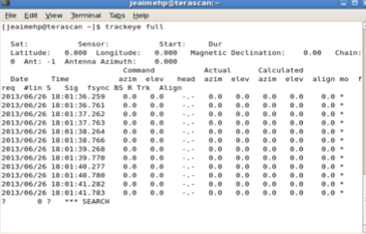
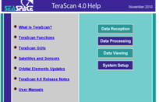
Introduction to TeraScan
Assessment Questions
Notes:
In this module viewers will learn about the SeaSpace technology known as TeraScan. Features software that will be used, How data is obtained, Key features and commonly used commands.

Slide 15
Conclusion
Created curriculum
Classroom Integration
Created modules
Notes:
In conclusion the seaspace technology curriculum will be Introduced to students, faculty, and administrators.
The Seaspace Training guide was used to provide a clear timeline of needed skills for TeraScan/TeraVision usage.
Also an overview of current courses available at ECSU were completed to determine suitable integration of collected data and image processing techniques
Our Training Modules entitled “Introduction to Remote Sensing” and “Introduction to TeraScan” were developed which include several deliverables.

Slide 16
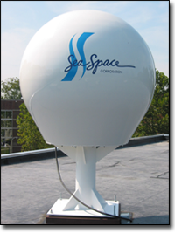
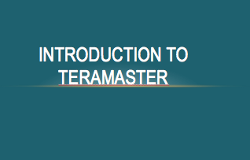
Future Research
Installation of Ground Stations (July 2013)
Creation of remaining modules
University CEU course certification
Meet with faculty to integrate
Test modules with K-12, undergraduates, graduates, government agency and officials
Schedule CEU courses
Notes:
To further this research first the ground stations must be installed and more learning modules created.
Once all modules in the CEU course are completed, they must be tested from respective educational categories. Once any adjustments are made, certification of training curriculum must be sought by the ECSU Distance Education Department to allow CEU accreditation. Lastly, periodic training schedules can be sent to local schools, governmental agencies, and Seaspace partners for continued use of the training site at ECSU.

Slide 17

Acknowledgements
The 2013 Remote Sensing Team would like to thank
REU Principal Investigator: Dr. Linda Hayden
Mentor: Mr. Je'aime Powell

Slide 18
Questions
Notes:
Common core:
earth/environmental science- understanding energy and conservation
How forces affect the atmosphere and analyze patters of global climate changes

